Slide 1
CS 1520 COMPUTER ARCHITECTURE
Microprocessors &
Assembly Language

Slide 2
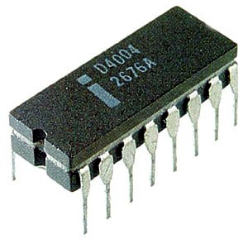
Microprocessors
Intel first microprocessor, named 4004.
4-bit of data (a nibble)
2000 transistors
46 instructions
Allow 4KB of program code
1 KB of data
2nd Generation: named 8008, 8080, 8085, handle 8-bits.
3rd Generation: 16bit processors 8086

Slide 3
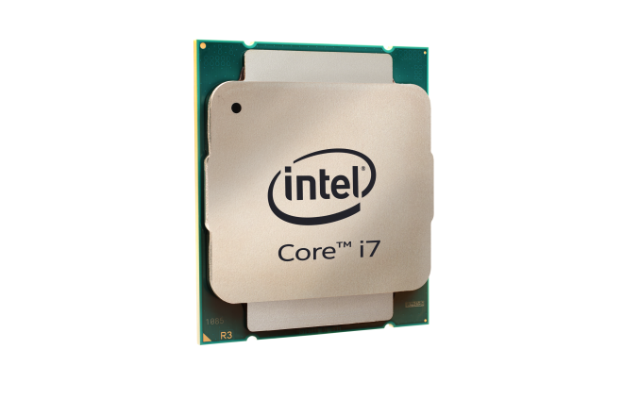
6th generation - Intel core i7 5960x
Notes:
More expensive, hotter, not worth to buy
8 cores – 8 cpu do things in parallel.

Slide 4
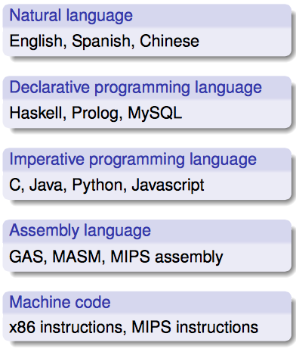
Levels of abstraction from computer hardware

Slide 5
Moving down the hierarchy
Natural language
Used by humans, ambiguous semantics
Translated to programming language by a programmer
Programming language
Well-defined syntax/semantics, portable to different architectures
Translated to assembly by a compiler
Assembly language
Mnemonic instructions for a specific architecture
Translated to machine code by an assembler
Machine code
Binary instructions for a specific architecture

Slide 6

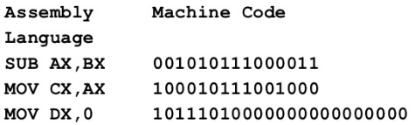
Machine Code & Assembly Language
Machine code programs are tedious to write and highly error prone
Assembly Language is an intermediate step between high languages and machine code

Slide 7
Why use assembly?
Easier than writing machine code!
Provides direct control of hardware components
Access to features not exposed in a higher-level language
Performance (dubious)
A good way to learn a computer architecture :)

Slide 8
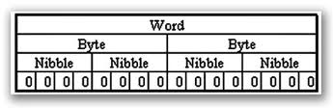
Nibble, Bytes and Words
Nibble – 4 bits (half a byte)
Information processed by the computer is stored in its memory
A memory circuit element can store one bit of data
Memory circuits are usually organized into groups that can store eight bits of data, and a string of eight bits is called a byte
Each memory byte circuit is identified by a number that is called its address
The first memory byte has address 0
The data stored in a memory byte are called its contents
Two bytes form a word

Slide 9
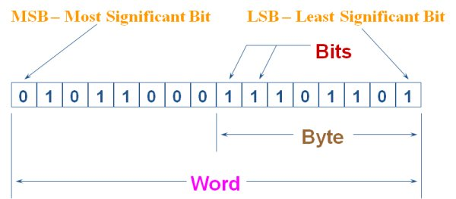
Bit Position
The positions are numbered from right to left, starting with 0
In a word, bits 0 to 7 form the low byte and bits 8 to 15 form the high byte

Slide 10
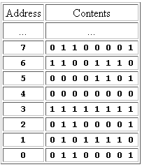
Address vs. Contents
The address of a memory byte is fixed and is different from the address of any other memory byte in the computer
The contents of a memory byte are not unique and are subject to change
The figure shows the organization of memory bytes; the contents are arbitrary
d

Slide 11
Addresses on Various Processors
Another distinction between address and contents is that while the contents of a memory byte are always eight bits, the number of bits in an address depends on the processor
For example, the Intel 8086 assigns a 20-bit address, and the Intel 80286 uses a 24-bit address
The number of bits used in the address determines the number of bytes that can be accessed by the processor

Slide 12
Example
Suppose a processor uses 20 bits for an address. How many memory bytes can be accessed?

Slide 13
Example
Suppose a processor uses 20 bits for an address. How many memory bytes can be accessed?
Solution:
A bit can have two possible values, so in a 20-bit address there can be 2²⁰ = 1,048,576 different values, with each value being the potential address of a memory byte
In computer lingo, the number 2²⁰ is called 1 mega -- thus a 20-bit address can be used to address one megabyte or 1MB
Notes:
http://www.shsu.edu/~csc_tjm/spring2005/cs272/asm_and_sys.html

Slide 14
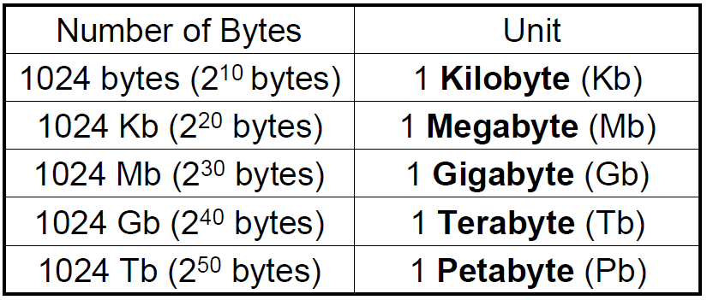

Slide 15
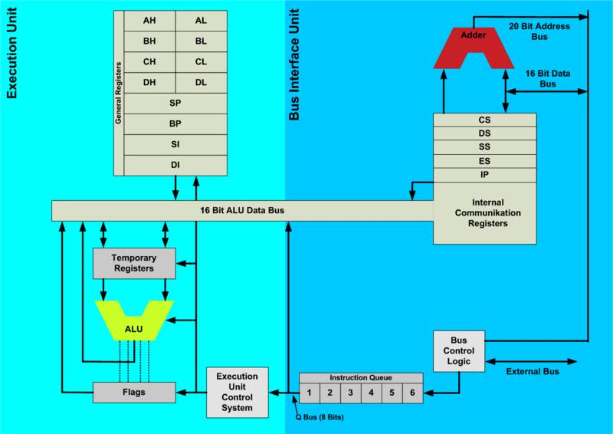
Intel 8086 architecture

Slide 16
Execution Unit (EU)
Executes instructions
Contains a circuit called the arithmetic and logic unit (ALU)
The ALU can perform arithmetic (+,-,*,/) and logic (AND, OR, NOT) operations
The data for the operations are stored in register circuits
Registers are like memory, only
much faster
referenced by name instead of number address

Slide 17
Registers
Registers are places in the CPU where a number can be stored and manipulated. There are three sizes of registers: 8-bit, 16-bit and on 386 and above 32-bit. There are four different types of registers: - general purpose registers, - segment registers, - index registers, - stack registers.

Slide 18
General purpose register

Slide 19
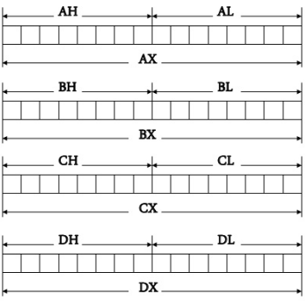
General purpose registers
AX, BX, CX and DX
They are all 16-bit registers
They are split up into 8-bit registers. AX is split up into AH which contains the high byte and AL which contains the low byte.

Slide 20
Index registers

Slide 21
Index Registers
sometimes called pointer registers
16-bit registers
mainly used for string instructions
SI (source index), DI (destination index) and IP (instruction pointer)

Slide 22
Stack registers

Slide 23
Stack Registers
BP and SP are stack registers
a stack is an area of memory which you can save and restore values to
a stack of plates -- Last On First Off (LOFO) or Last In First Out (LIFO)

Slide 24
Assembly language concepts

Slide 25
Assembly language programming
High-level languages are portable
Why use low-level languages?
Access to primitive operations (e.g., bit manipulations); access to CPU registers and interrupt handling
More efficient
To understand more fully how computers operate

Slide 26
Variables in assembly language
Variables must be declared before being used
Declare the name and size of the variables
A directive (a command to the assembler) is used to define variables
db defines a byte-sized variable
dw defines a word-sized variable (16 bits)
dd defines a double-word (32 bits)

Slide 27
Example variable declarations
reply db ‘y’
prompt db ‘Enter the color:’, 0
color db 80dup(?)
i db 20
k db ?
num dw 4000
large dd 80000

Slide 28
Example variable declarations
A character variable initialized to ‘y’
reply db ‘y’
prompt db ‘Enter the color:’, 0
color db 80dup(?)
i db 20
k db ?
num dw 4000
large dd 80000

Slide 29
Example variable declarations
reply db ‘y’
prompt db ‘Enter the color:’, 0
color db 80dup(?)
i db 20
k db ?
num dw 4000
large dd 80000
A string, terminated by the NULL character

Slide 30
Example variable declarations
reply db ‘y’
prompt db ‘Enter the color:’, 0
color db 80dup(?)
i db 20
k db ?
num dw 4000
large dd 80000
An array of characters of size 80, which contains undefined values.
80 bytes of storage are to be set aside

Slide 31
Example variable declarations
reply db ‘y’
prompt db ‘Enter the color:’, 0
color db 80dup(?)
i db 20
k db ?
num dw 4000
large dd 80000
i is initialised to 20
k is undefined

Slide 32
Example variable declarations
reply db ‘y’
prompt db ‘Enter the color:’, 0
color db 80dup(?)
i db 20
k db ?
num dw 4000
large dd 80000
num is 16 bit, initialised to 4000
large is 32 bit, initialised to 80000

Slide 33
Assembly language instructions
C code:
int i, j, k;
i = 1;
i = i + 4;
j = 2;
k = i + j;
How to write the above code in assembly language?

Slide 34
Assembly language instructions
C code:
int i, j, k;
i = 1;
i = i + 4;
j = 2;
k = i + j;
Assembly language:
i dw ?
j dw ?
k dw ?
mov i, 1
add i, 4
mov j, 2
mov ax, j
add ax, i
mov k, ax

Slide 35
k = i + j
as
mov ax, j
add ax, i
mov k, ax
Cannot write:
add k, i

Slide 36
k = i + j
as
mov ax, j
add ax, i
mov k, ax
Cannot write:
add k, i ; this is ILLEGAL !!!!!
Rule for 8086: the source and destination operands may not both be memory variables in the same instruction

Slide 37
C
sum = result1 + result2 + result3;
Assembly language
mov ax, result1
add ax, result2
add ax, result3
mov sum, ax

Slide 38
Store the character ‘A’ in register bx:
mov bx, ‘A’
mov bx, 65D ;decimal
mov bx, 41H ;hexadecimal
mov bx, 01000001B ;ASCII code in binary
We don’t need to know the ASCII codes of printable characters
use the ASCII code for non-printable control characters, e.g., Carriage Return (ASCII 13D), Linefeed (ASCII 10D), Bel (ASCII 7D)

Slide 39
Notation
Assembly language instructions may be written in either upper case, lower case, or mixed case
Mov, mov, MOV are all acceptable

Slide 40
Ambiguity
Consider the instruction mov dl, ah
Does it mean ‘copy the contents of register ah to dl or
Does it mean ‘copy A in hexadecimal into register dl
To avoid this ambiguity all hexadecimal numbers must start with a number. This can always be done by preceding a number starting with A,B,C,D,E and F with a preceding zero to remove ambiguity
mov dl, ah ;means copy AH to DL
mov dl, 0ah ;means move hexadecimal A to DL

Slide 41
add, inc, dec and sub instructions
Example:
mov ax, 5 ;load 5 into ax
add ax, 3 ;add 3 to the contents of ax,
;ax now contains 8
inc ax ;add 1 to ax
;ax now contains 9
dec ax ;subtract 1 from ax
;ax now contains 8
sub ax, 6 ;subtract 4 from ax
;ax now contains 2

Slide 42
Constants
constant values are known as equates
Count EQU 10 Number EQU 5 Price = Count * Number MyCat EQU "Giully"
after declaring a symbol with EQU you cannot change its associated value
the values declared with "=" can be changed as often as you want
EQU can declare all kinds of equates including numbers, expressions and characters

Slide 43
Sub-programs
Calling the sub-program add_regs:
mov cx, 10
mov bx, 15
call add_regs ;
mov sum ax
Defining the add_regs sub-program:
add_regs:
mov ax, 0
add ax, bx
add ax, cx
ret ;ax will contain bx+cx
We use a label to name a sub-program
Labels are for loops and selection statements

Slide 44
Input and Output (I/O)
We must have a means to call the operating system to perform I/O
We must be able to specify what kind of I/O operation we wish to carry out (e.g., read a character from the keyboard, display a character on the screen, or do disk I/O)
An interrupt signals the processor to suspend its current activity (i.e. running your program) and to pass control to an interrupt service program (i.e. part of the operating system).

Slide 45
Input and Output (I/O)
The instruction int 21h transfers control to the operating system, to a subprogram that handles I/O operations
You must also specify which I/O operation (e.g. read a character, display a character) you wish to carry out. This is done by placing a specific number in a register. The ah register is used to pass this information.

Slide 46
Input and Output (I/O)
For example,
mov ax, 01H
int 21H
21H tells the operating system to access one of its many I/O sub-programs
Use the number in ax register to determine which of its I/O sub-programs to invoke
01H indicates that it is the ‘read character from keyboard’ sub-program

Slide 47
Terminating a program
Explicitly terminate our programs and return control to the operating system.
Use int instruction:
mov ax, 4c00h
int 21h

Slide 48
Character Output
Display a single character on the screen
storing the character’s ASCII code in the dl register
specify which of MS-DOS’s I/O subprograms we wish to use. We store the subprogram number 2h in the ah register
we interrupt our program and transfer control to the MS-DOS subprogram that we have specified using the ah register.

Slide 49
Character Output
C version:
putchar( ‘a‘ ) ;
8086 version:
mov dl, ‘a‘ ; dl = ‘a‘
mov ah, 2h ; character output subprogram
int 21h ; call ms-dos output character
As you can see, this simple task is quite complicated in assembly language.

Slide 50
Conditional Statements
Evaluate the condition (result is stored in the status register)
Transfer control to the appropriate point
C (assume i stands for ax and j stands for bx):
if ( i == j) {
i = i + 10;
j = j – 10;
}else {
i = i + 2;
j = j – 2;
}
How about in assembly language?

Slide 51
Conditional Statements
Assembly language:
cmp ax, bx
je eq_lab ;if ax==bx, go to eq_lab
add ax, 2
sub bx, 2
jmp endif
eq_lab:
add ax, 10
sub bx, 10
endif:
je: conditional jump
jmp: unconditional jump

Slide 52
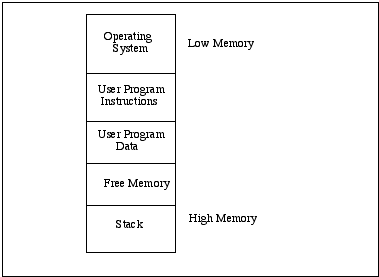
Stack
A stack is an area of memory which is used for storing data on a temporary basis.
illustrates how memory might be allocated to a user program running.

Slide 53
Stack
The area of memory used for your program code is fixed, i.e. once the code is loaded into memory it does not grow or shrink.
The size of the stack varies during program execution. We can store information on the stack and retrieve it later.
Common use: the implementation of the subprogram facility
The return address of a subprogram is placed on the stack by the call instruction.
When the subprogram finishes, the ret instruction retrieves the return address from the stack and transfers control to the correct location.

Slide 54
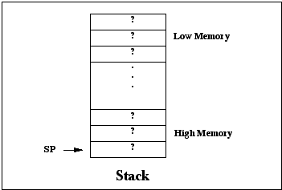
sp is decremented by the size of the element (2 bytes for the 8086)

Slide 55
stack pointer (sp)
sp: keep track of where items are stored
It points to the top of the stack
If a number of elements on the stack, the pointer always point to the last element we placed on the stack)
stack operations
push ax ;the value of ax stored on the stack
pop ax ;transfers the data from the top of the ;stack to ax
Last-In-First-Out (LIFO) process
the last item placed on the stack is the first item to be retrieved
For the 8086, we can only push 16-bit items onto the stack
The following are ILLEGAL:
push al
pop bh

Slide 56
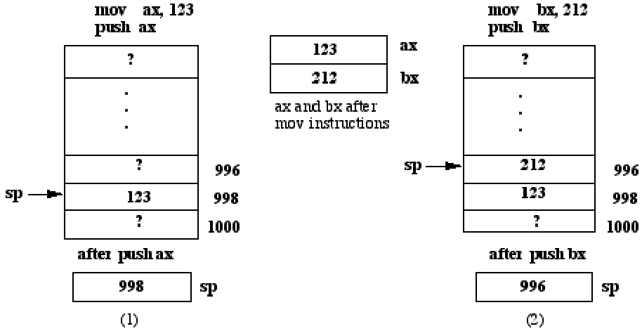

Slide 57
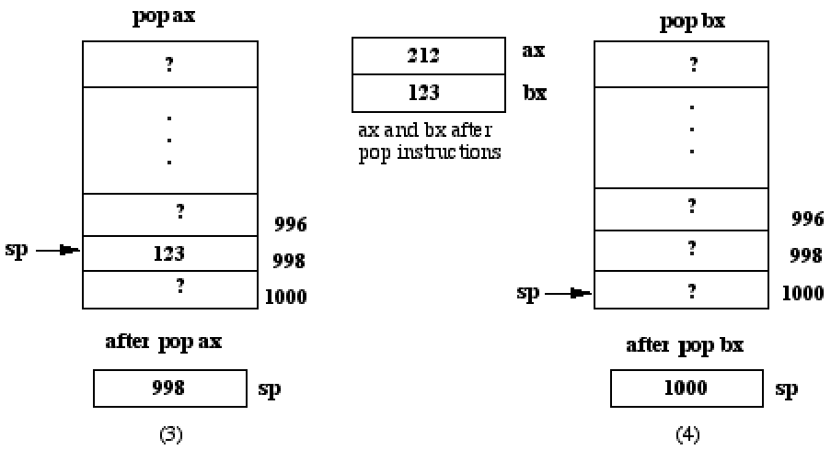

Slide 58
Using the stack, swap the values of the ax and bx registers.
Version 1:
push ax
push bx
pop ax
pop bx
Version 2 (more efficient):
push ax
mov ax, bx
pop bx

